Slide 1

Online Doctor Appointment System
Presented by
Ammar Aziz F21ietbs005
Ahtisham Qasim F21ietbs012
M.Ali Sikandar F21ietbs041
Ameer ullah F21ietbs031
Presented to
Dr. bilal shahnawaz

Slide 2
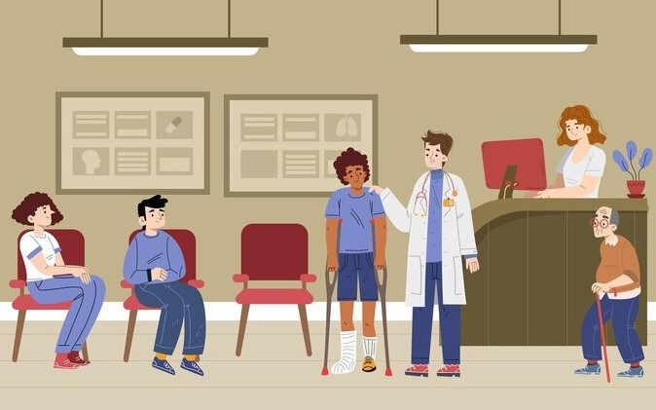
Problem Statement
Long waiting periods
Time-consuming processes
Lack of accessibility of doctors

Slide 3
Purpose Model
Efficient Appointment Management
Accurate Appointment Scheduling
Improved Healthcare Access
Enhanced Doctor Efficiency

Slide 4
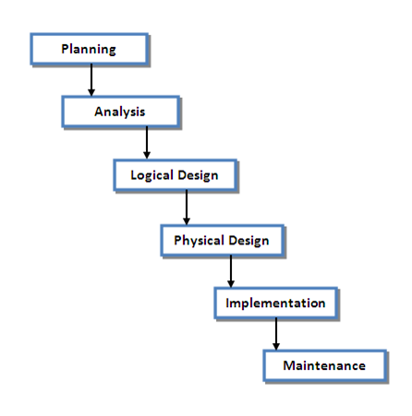
SDLC
Approach use for database development

Slide 5
Business Rules
Hospital-Doctor
Doctor-Appointment
Patient-Appointment
Patient-Payment
Appointment-Receipt
Payment-Receipt

Slide 6
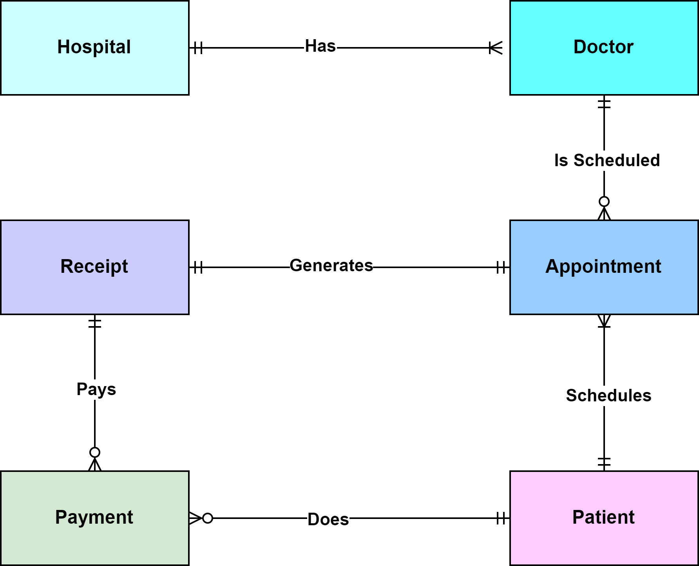
Entity Relationship Diagram (ERD)

Slide 7
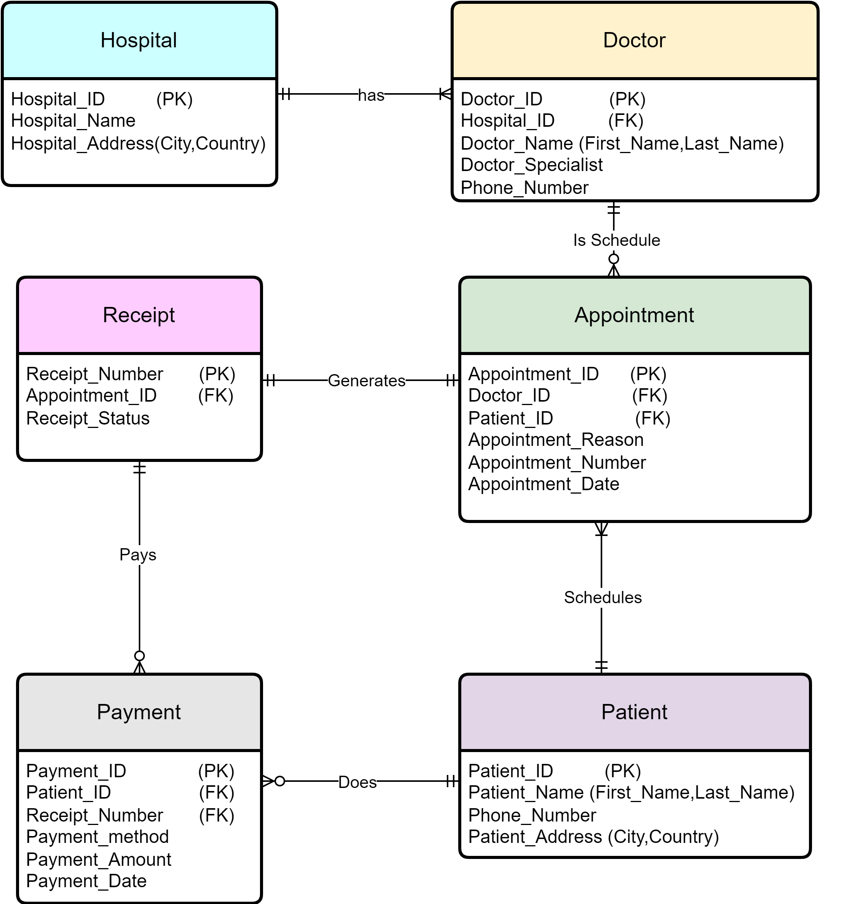
Logical Data Model

Slide 8
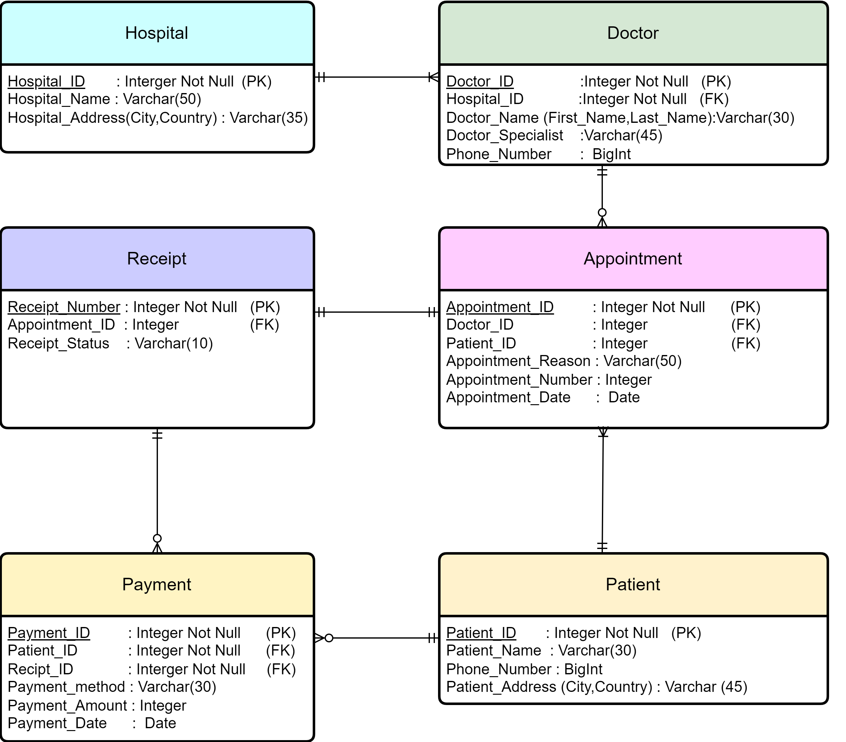
Physical Data Model

Slide 9

Tools AND LANGUAGES
DRAW.IO
SQL Server Manager
SQL

Slide 10
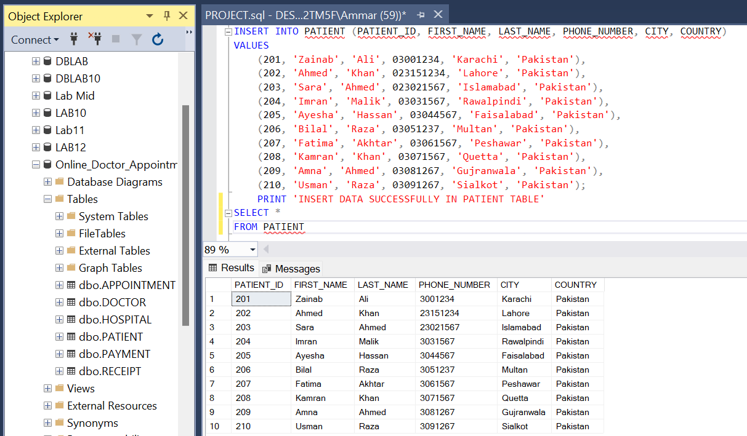
Demo Implementation

Slide 11
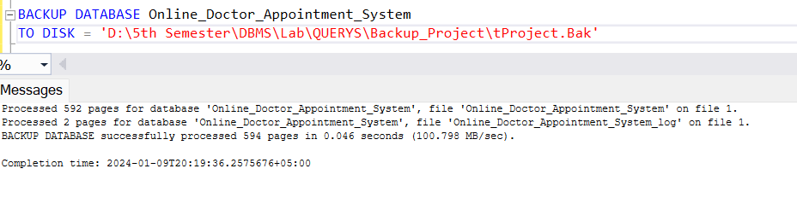
Maintenance
Database Monitoring
Backup the Database

Slide 12

Conclusion
In conclusion, an online doctor appointment system represents a pivotal innovation in healthcare accessibility and efficiency. By leveraging digital platforms, it addresses the challenges of traditional appointment scheduling, offering patients convenient access to healthcare services while streamlining workflows for healthcare providers.

Slide 13


